Slide 1
B-Tree

Slide 2
B-Tree
Balance m-way tree, where m is order of the tree.
Generalization of BST in which a node can have more than one key and more than 2 children.
Contains sorted data.
All leaf nodes must be at the same level
Used for multilevel indexing

Slide 3
B-Tree
When it comes to storing and searching large amounts of data, traditional binary search trees can become impractical due to their poor performance and high memory usage.
B-Trees, also known as B-Tree or Balanced Tree, are a type of self-balancing tree that was specifically designed to overcome these limitations.
Unlike traditional binary search trees, B-Trees are characterized by the large number of keys that they can store in a single node, which is why they are also known as “large key” trees.
Each node in a B-Tree can contain multiple keys, which allows the tree to have a larger branching factor and thus a shallower height.
This shallow height leads to less disk I/O, which results in faster search and insertion operations.
B-Trees are particularly well suited for storage systems that have slow, bulky data access such as hard drives, flash memory, and CD-ROMs.

Slide 4
Properties of B-Tree
All leaves are at the same level.
B-tree of order m has the following properties:
Every node has max m children
Min children: for leaf: 0, for root: 2, for internal nodes: ceil(m/2)
Every node has max m-1 key values
Min key: for root: 1, other nodes: ceil(m/2)-1
B-Tree grows and shrinks from the root which is unlike Binary Search Tree. Binary Search Trees grow downward and also shrink from downward.
Like other balanced Binary Search Trees, the time complexity to search, insert, and delete is O(log n).
Insertion of a Node in B-Tree happens only at Leaf Node.

Slide 5
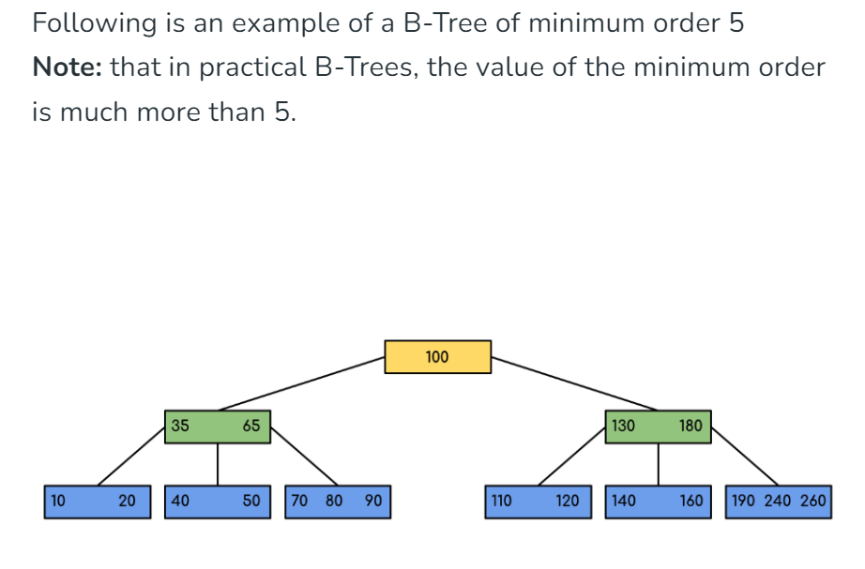
Example

Slide 6
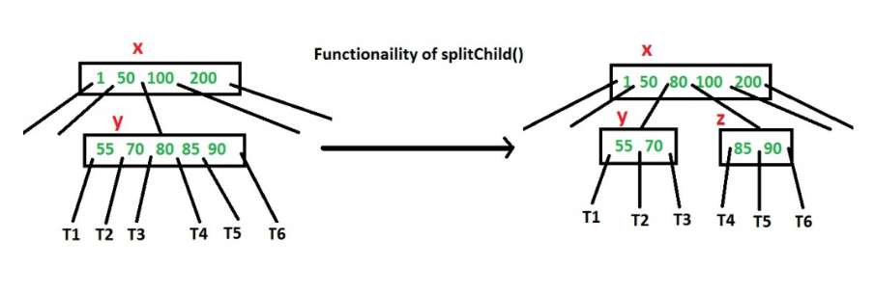
Insertion in B-Tree
A new key is always inserted at the leaf node. Let the key to be inserted be k. Like BST, we start from the root and traverse down till we reach a leaf node. Once we reach a leaf node, we insert the key in that leaf node. Unlike BSTs, we have a predefined range on the number of keys that a node can contain. So before inserting a key to the node, we make sure that the node has extra space.
How to make sure that a node has space available for a key before the key is inserted? We use an operation called splitChild() that is used to split a child of a node.

Slide 7
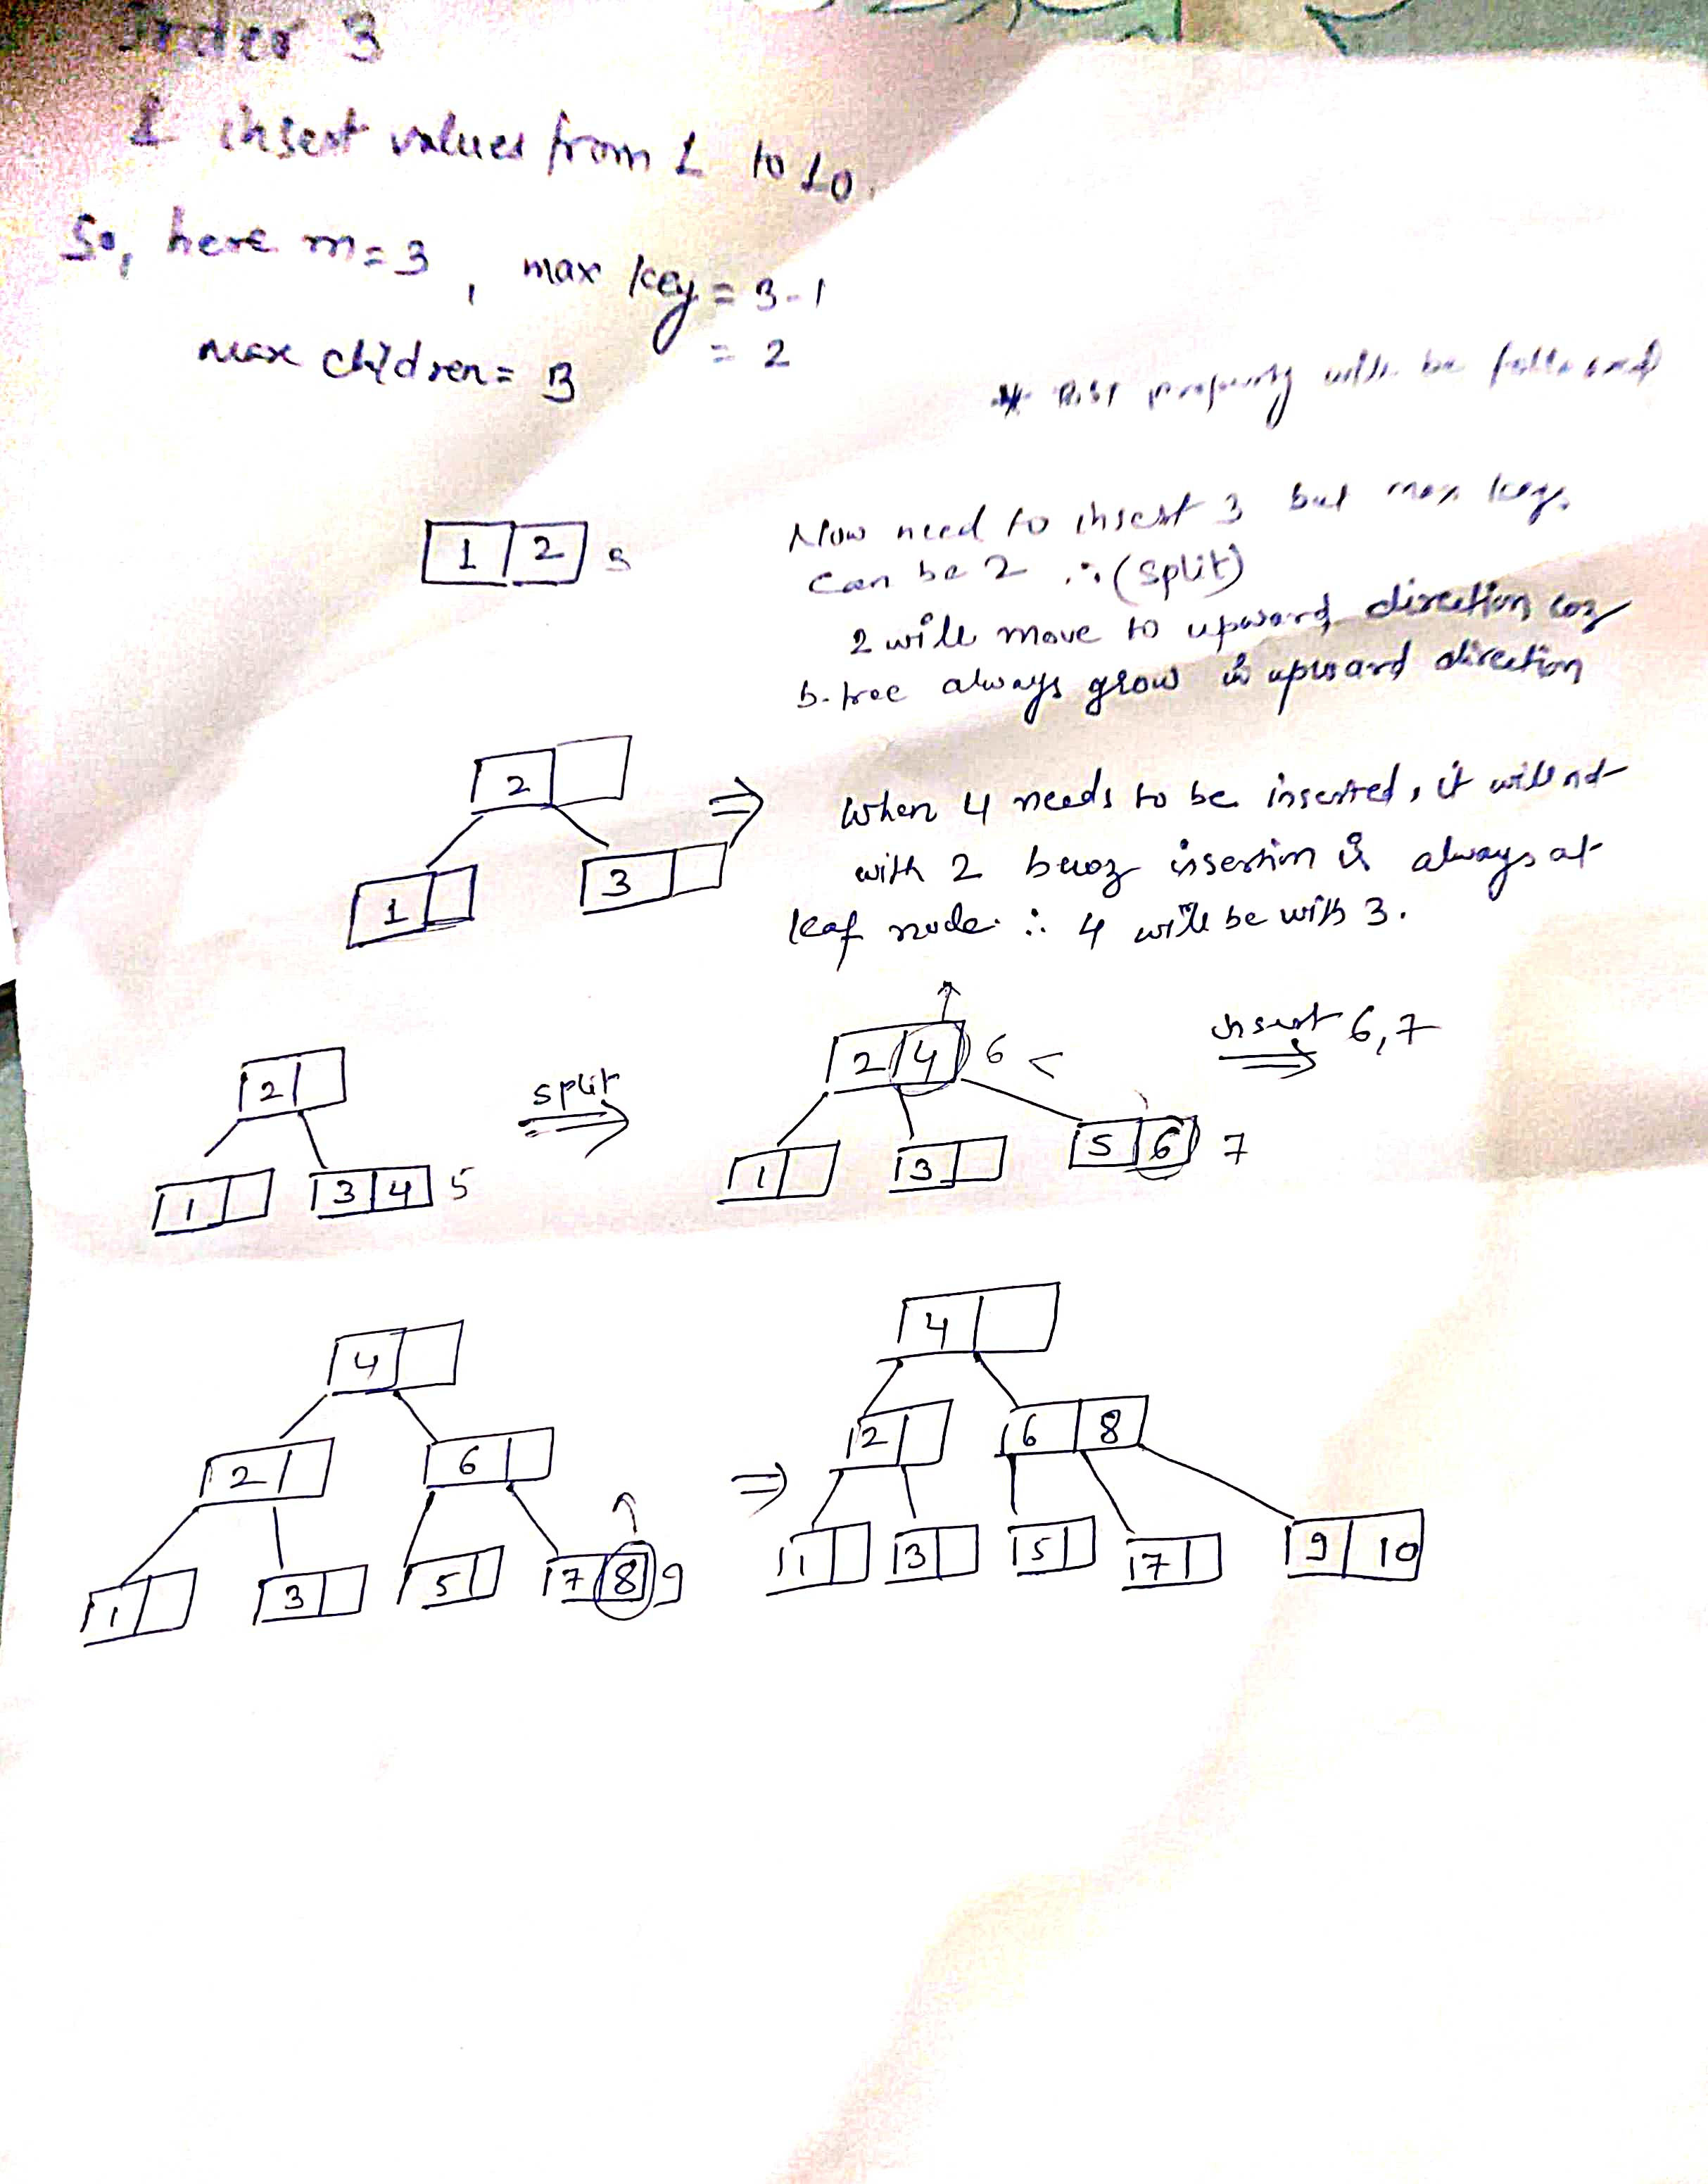
Insertion in B-Tree

Slide 8
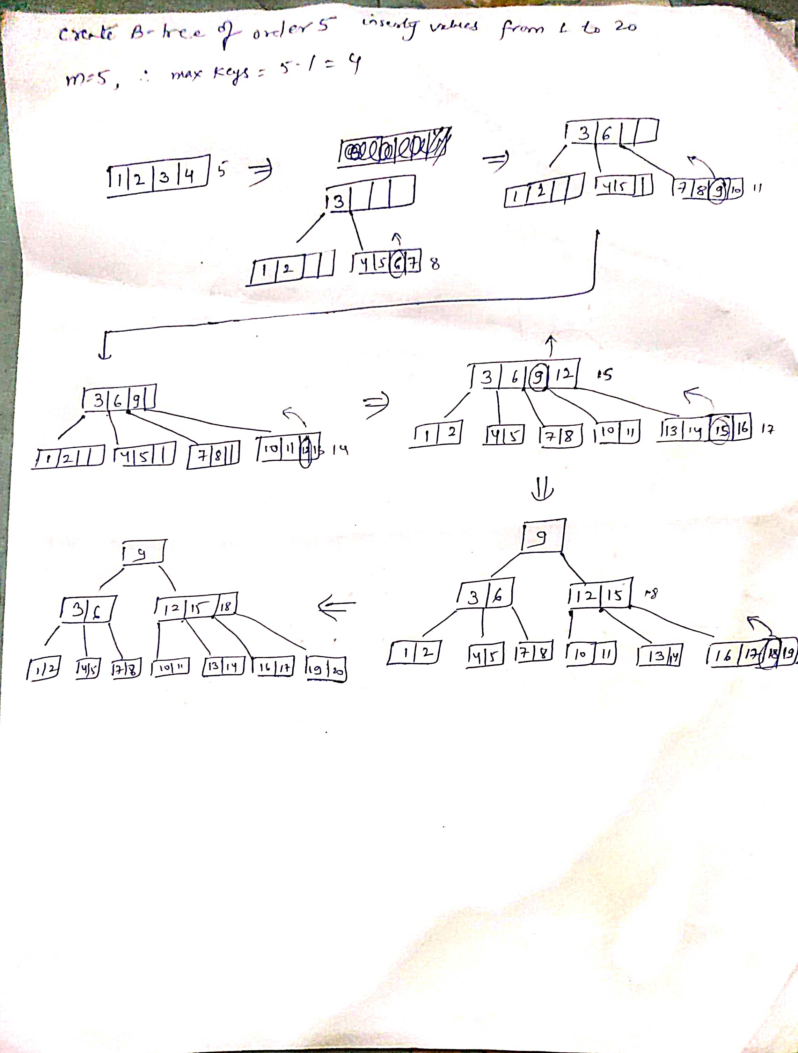

Slide 9
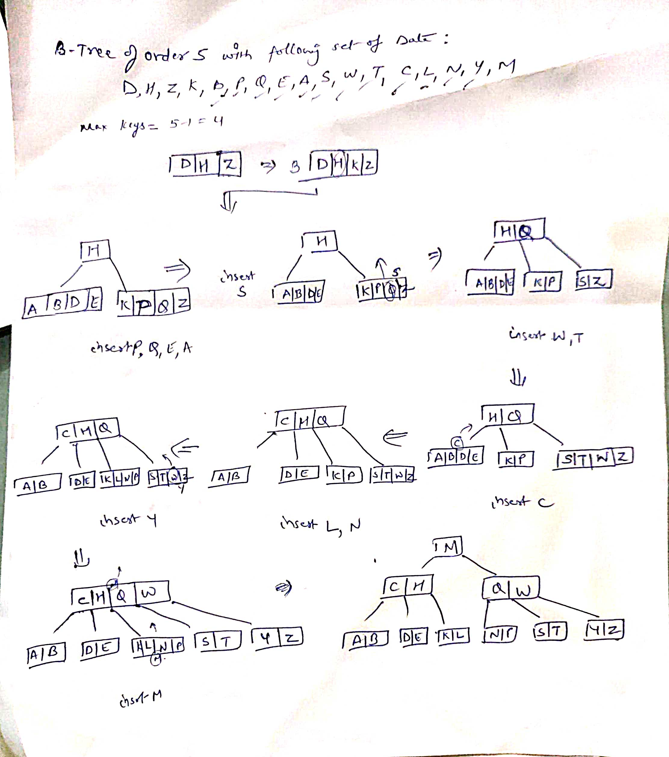

Slide 10
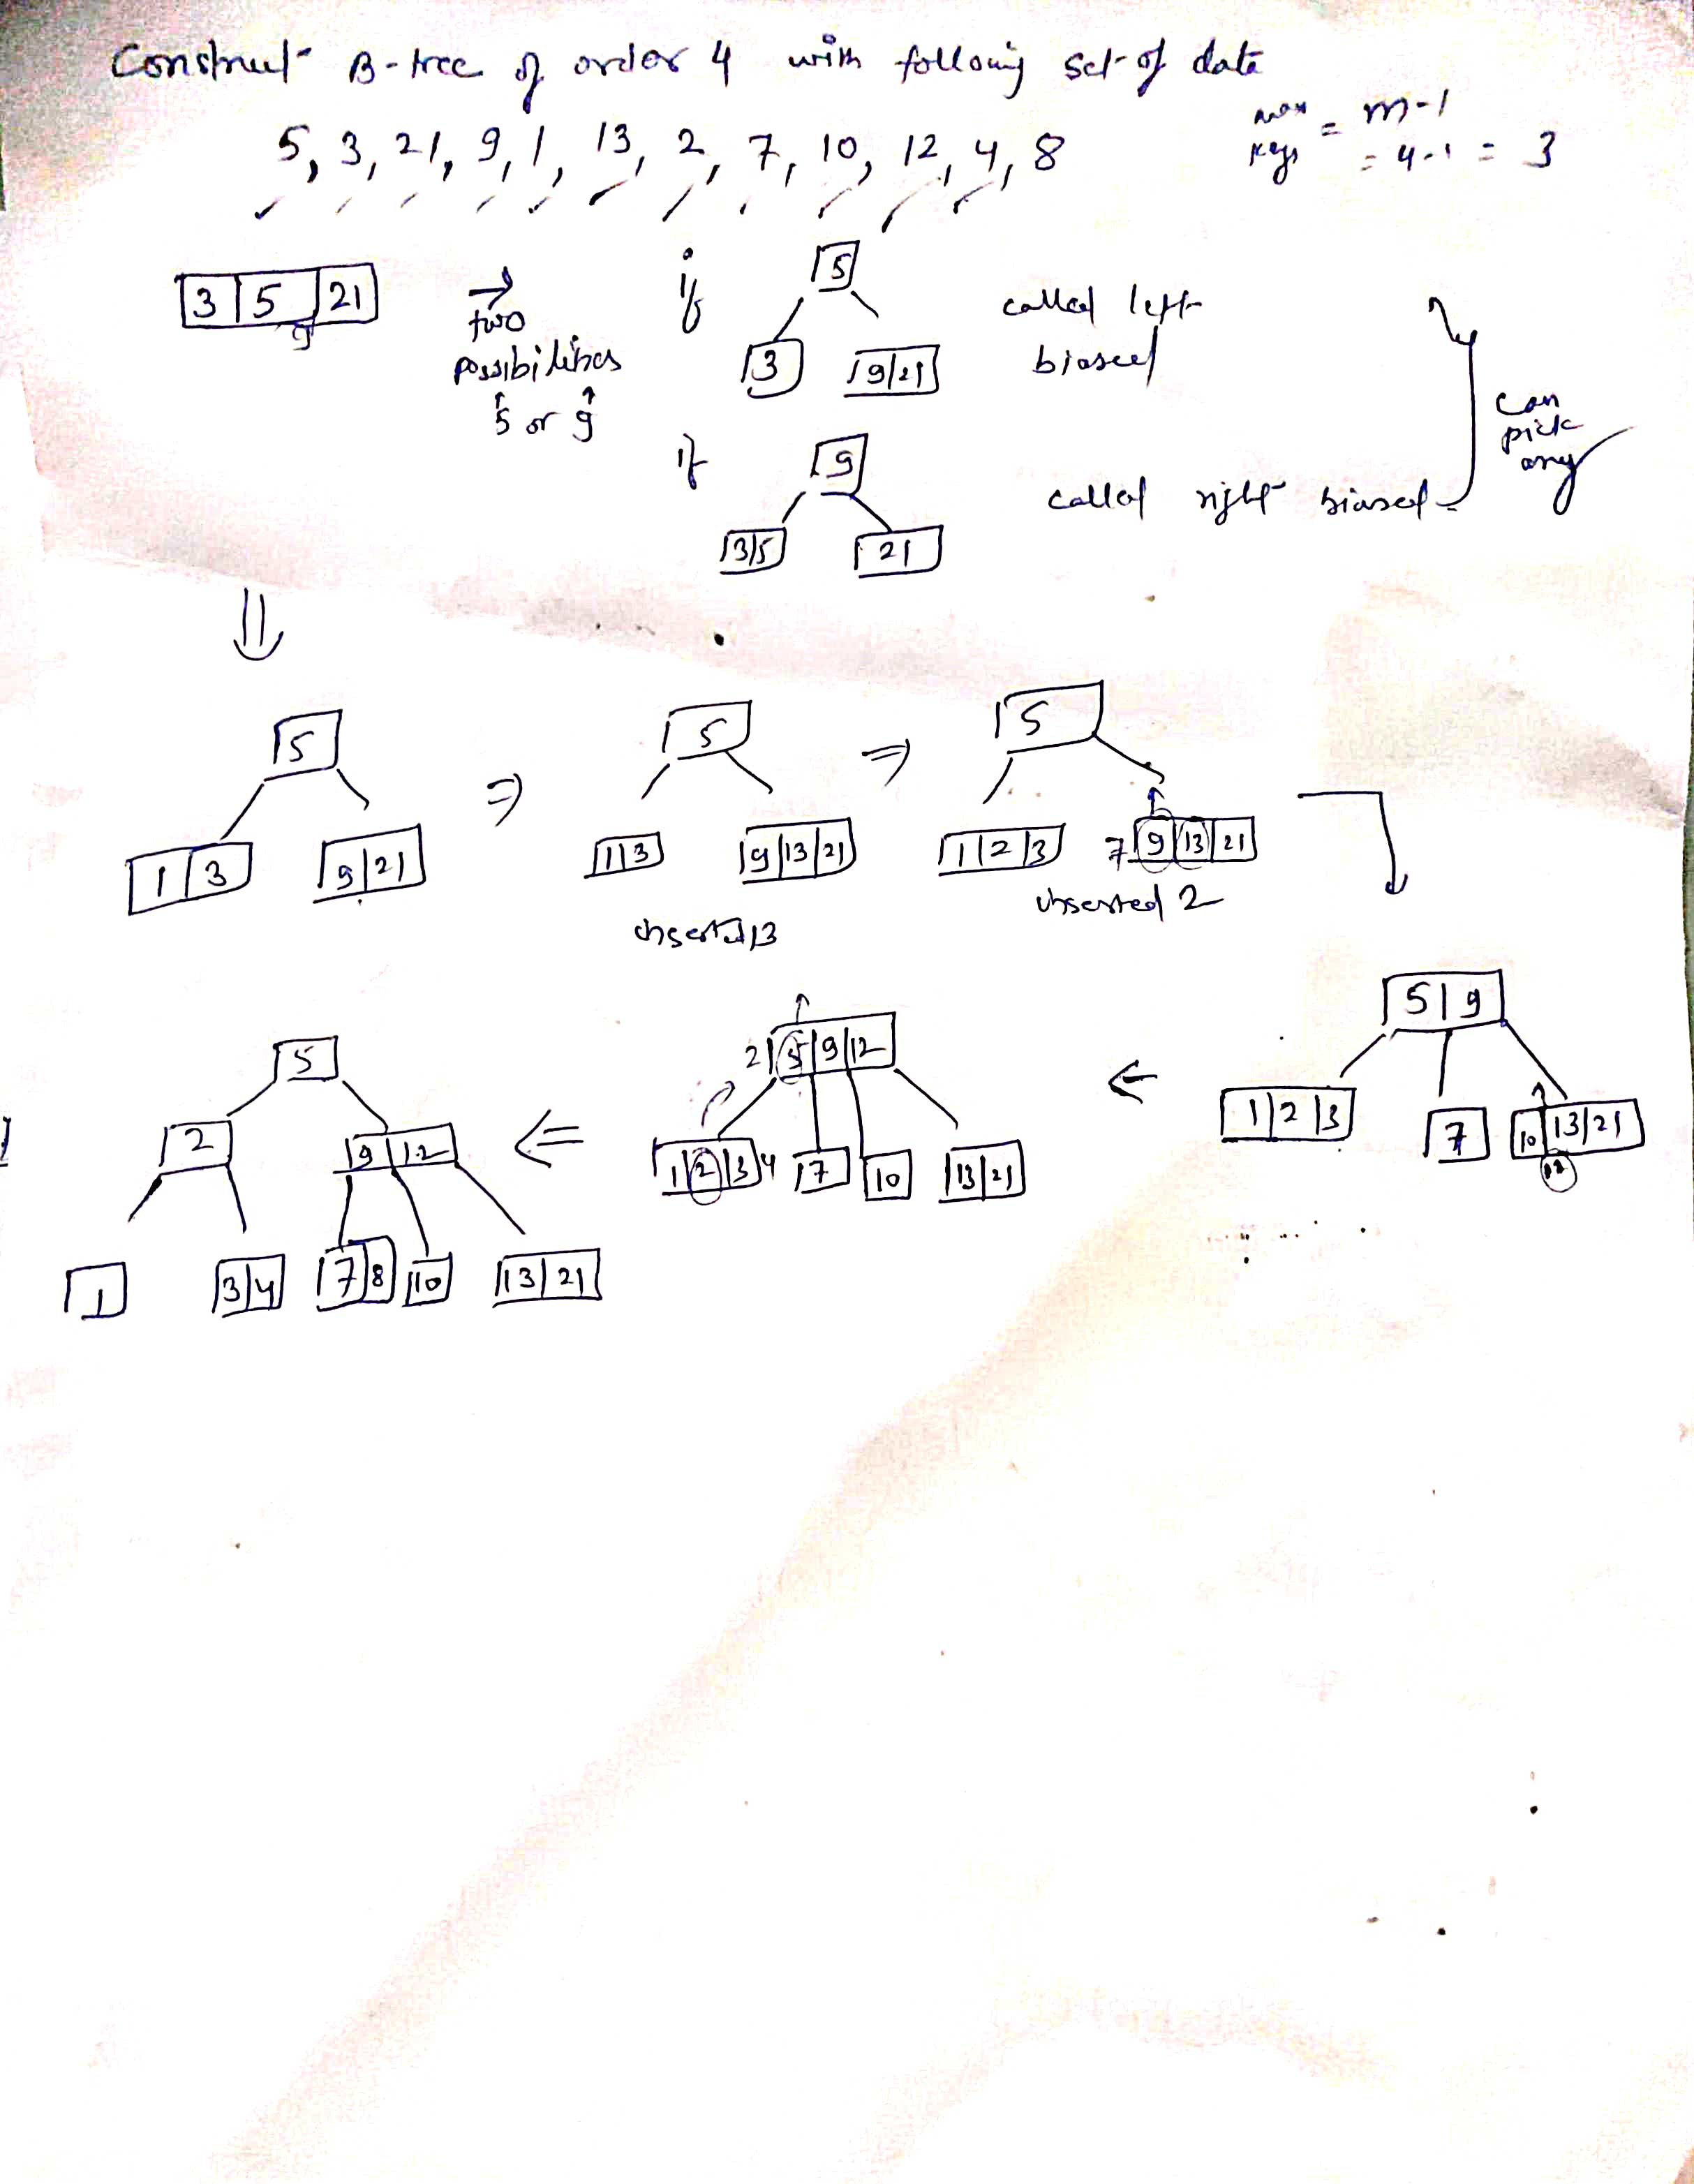

Slide 11
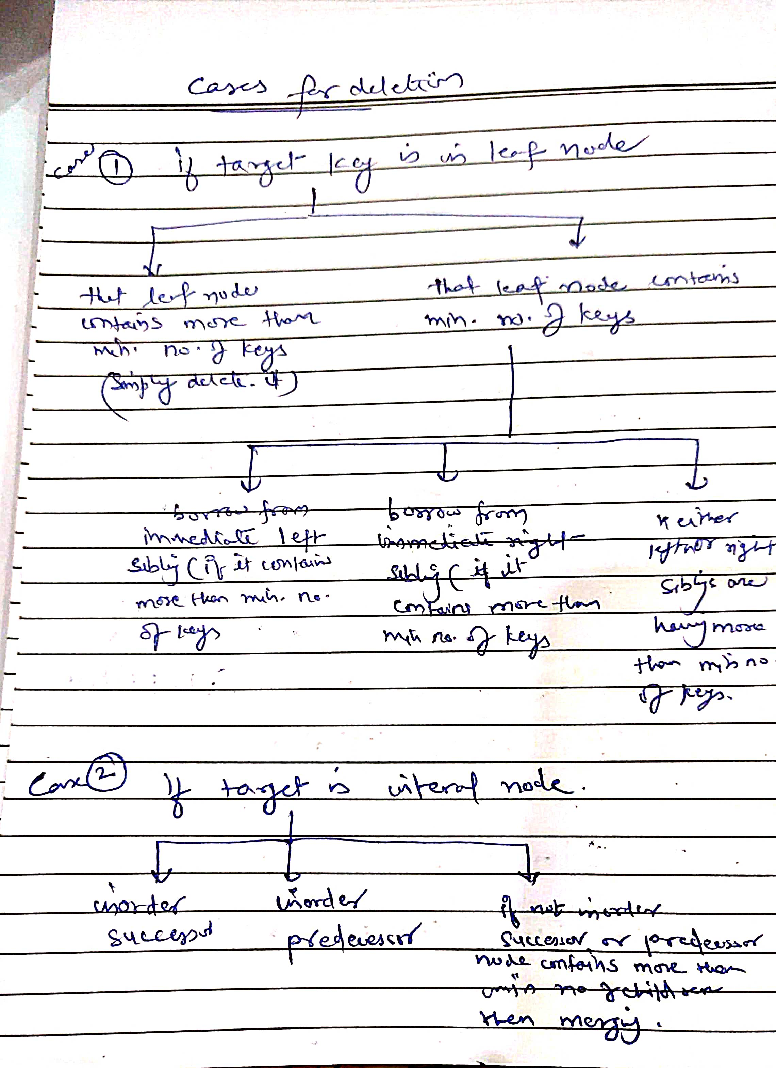
Deletion in B-Tree

Slide 12
Examples
Refer shared PDF

Slide 13
B-Tree Example with m = 5
12
2
3
8
13
27
The root has been 2 and m children.
Each non-root internal node has between ⎡m/2⎤ and m children.
All external nodes are at the same level. (External nodes are actually represented by null pointers in implementations.)

Slide 14
Insert 10
12
2
3
8
10
13
27
We find the location for 10 by following a path from the root using the stored key values to guide the search.
The search falls out the tree at the 4th child of the 1st child of the root.
The 1st child of the root has room for the new element, so we store it there.

Slide 15
Insert 11
12
2
3
8
10
11
13
27
We fall out of the tree at the child to the right of key 10.
But there is no more room in the left child of the root to hold 11.
Therefore, we must split this node...

Slide 16
Insert 11 (Continued)
8
12
2
3
10
11
13
27
The m + 1 children are divided evenly between the old and new nodes.
The parent gets one new child. (If the parent become overfull, then it, too, will have to be split).

Slide 17
Remove 8
8
12
2
3
10
11
13
27
Removing 8 might force us to move another key up from one of the children. It could either be the 3 from the 1st child or the 10 from the second child.
However, neither child has more than the minimum number of children (3), so the two nodes will have to be merged. Nothing moves up.

Slide 18
Remove 8 (Continued)
12
2
3
10
11
13
27
The root contains one fewer key, and has one fewer child.

Slide 19
Remove 13
12
2
3
10
11
13
27
Removing 13 would cause the node containing it to become underfull.
To fix this, we try to reassign one key from a sibling that has spares.

Slide 20
Remove 13 (Cont)
11
2
3
10
12
27
The 13 is replaced by the parent’s key 12.
The parent’s key 12 is replaced by the spare key 11 from the left sibling.
The sibling has one fewer element.

Slide 21
Remove 11
11
2
3
10
12
27
11 is in a non-leaf, so replace it by the value immediately preceding: 10.
10 is at leaf, and this node has spares, so just delete it there.

Slide 22
Remove 11 (Cont)
10
2
3
12
27

Slide 23
Remove 2
10
2
3
12
27
Although 2 is at leaf level, removing it leads to an underfull node.
The node has no left sibling. It does have a right sibling, but that node is at its minimum occupancy already.
Therefore, the node must be merged with its right sibling.

Slide 24
Remove 2 (Cont)
3
10
12
27
The result is illegal, because the root does not have at least 2 children.
Therefore, we must remove the root, making its child the new root.

Slide 25
Remove 2 (Cont)
3
10
12
27
The new B-tree has only one node, the root.

Slide 26
Insert 49
3
10
12
27
Let’s put an element into this B-tree.

Slide 27
Insert 49 (Cont)
3
10
12
27
49
Adding this key make the node overfull, so it must be split into two.
But this node was the root.
So we must construct a new root, and make these its children.

Slide 28
Insert 49 (Cont)
12
3
10
27
49
The middle key (12) is moved up into the root.
The result is a B-tree with one more level.

Slide 29
Traversal in B-Tree:
Traversal is also similar to Inorder traversal of Binary Tree. We start from the leftmost child, recursively print the leftmost child, then repeat the same process for the remaining children and keys. In the end, recursively print the rightmost child.

Slide 30
2-3 Trees
A B-tree of order m is a kind of m-way search tree.
A B-Tree of order 3 is called a 2-3 Tree.
In a 2-3 tree, each internal node has either 2 or 3 children.
In practical applications, however, B-Trees of large order (e.g., m = 128) are more common than low-order B-Trees such as 2-3 trees.

Slide 31
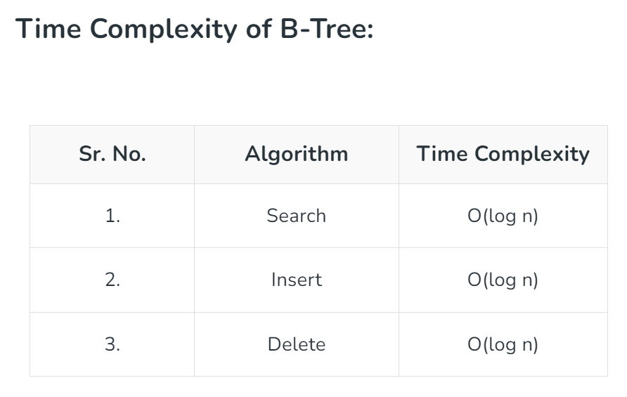

Slide 32
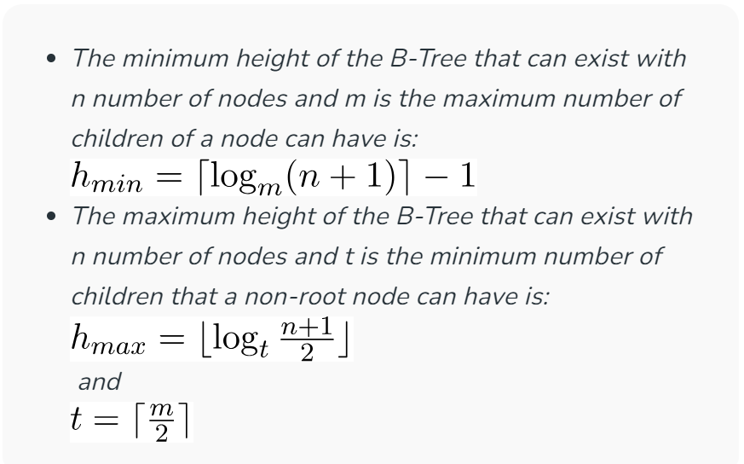
Interesting facts about B-Tree

